Slide 1
Networks Extensions
TSP, Vehicle Routing Problems
Inventory Vehicle Routing Problem
Locating ATM’s
Richard Larson
1.203J, 15.073J, IDS.700
November 29, 2017

Slide 2
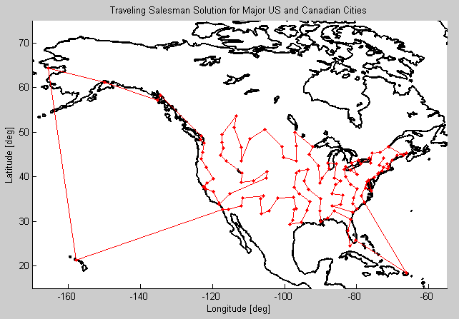
1. Traveling Salesman Problem (TSP)
Huge literature, endless applications
  Job shop scheduling
  Vehicle routing problem (VRP)
  Dial-a-ride problem (DARP)
  Electronics industry
  On-line grocery stores
  Air traffic control
  Genome sequencing
  Space applications
Look at a couple of important heuristics; a great approximation for Euclidean tours
http://blogs.mathworks.com/pick/2011/10/14/traveling-salesman-problem-genetic-algorithm/

Slide 3
Traveling Salesman Problem
Find the shortest tour (length or time), starting and ending at a specified node, O, and visiting each of (n-1) specified nodes A, B, C, etc. at least once.
There are (n - 1)! different orderings of the points to be visited, thus (n - 1)!/2 different solutions of the TSP.
10 nodes: 1,814,400 possible solutions
20 nodes: 1.2 x 10¹⁸.
Exact solutions: Forget about it!

Slide 4
Heuristics: Euclidean TSP
8
3
9
1
2
7
10
4
5
6

Slide 5
The MST Heuristic for the TSP
See Urban OR Text for Full Details
8
3
9
1
2
7
10
4
5
6

Slide 6
Merging with a second copy of the MST
8
3
9
1
2
7
10
4
5
6

Slide 7
Improve Solution by Skipping Points Already Visited
8
3
9
1
2
7
10
4
5
6

Slide 8
Improve Solution by Skipping Points Already Visited
8
3
9
1
2
7
10
4
5
6

Slide 9
Improve Solution by Skipping Points Already Visited
8
3
9
1
2
7
10
4
5
6

Slide 10
Further Improvements
8
3
9
1
2
7
10
4
5
6

Slide 11
Further Improvements
8
3
9
1
2
7
10
4
5
6

Slide 12
Even More Improvements (347 units)
8
3
9
1
2
7
10
4
5
6

Slide 13
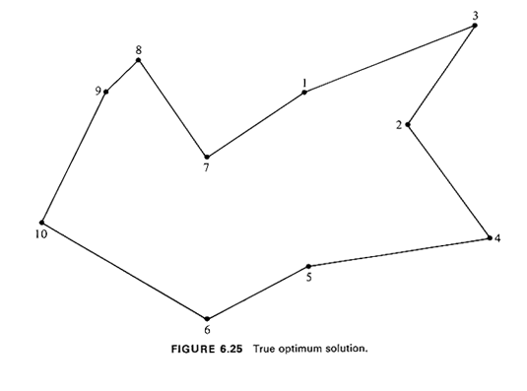
Optimal Tour (331 units)

Slide 14
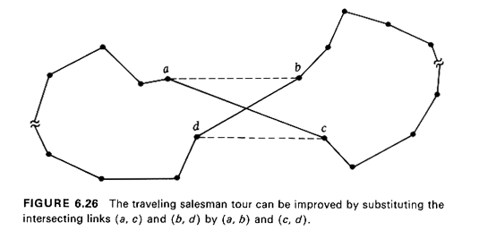
Convex Hull Heuristic (Euclidean TSP)
Optimal TSP tour cannot intersect itself (Why?)
Therefore, points on the convex hull must appear in same order on optimal TSP tour (Why?)
Provides good starting point; for instance, improves insertion heuristics by 2-3%, on average

Slide 15
The Convex Hull Heuristic: Euclidean Plane
8
3
9
1
2
7
10
5
4
6

Slide 16
Adding New Points
8
3
9
1
2
7
10
5
4
6

Slide 17
Adding New Points
8
3
9
1
2
7
10
5
4
6

Slide 18
Adding New Points
8
3
9
1
2
7
10
5
4
6

Slide 19
Adding New Points
8
3
9
1
2
7
Turns out to be the Optimal Solution!
10
5
4
6

Slide 20
Probabilistic View of the Euclidean Traveling Salesman Problem
In X-Y plane suppose we have optimal TSP tour thru points (x_{i}, y_{i}).
Expand area m-fold, implies each (x_{i}, y_{i}) becomes ( x_{i}, y_{i})
Implies length of the new TSP tour will be times the length of original one. Why?
A quadrupling of area will double tour length.

Slide 21
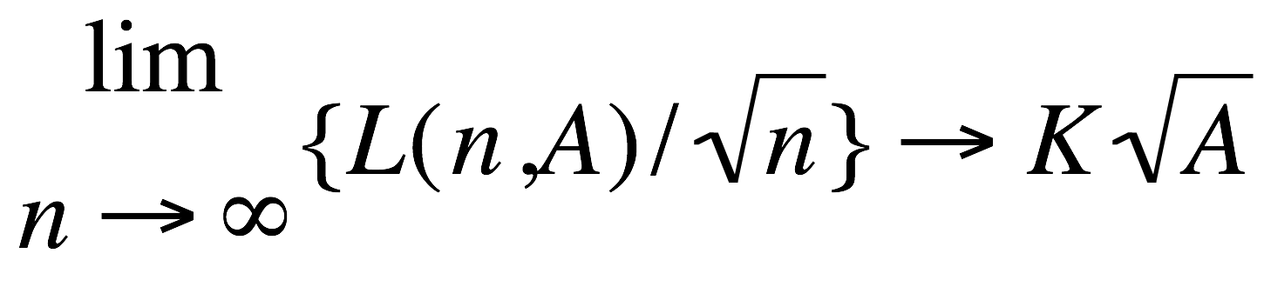
Probabilistic View of the Euclidean Traveling Salesman Problem
We thus have: the length L(n,A) of a given traveling salesman tour varies in proportion to the square root of the area in which it is contained.
Remarkable result. Assume iid uniform locations of n points. Then, with probability 1,

Slide 22
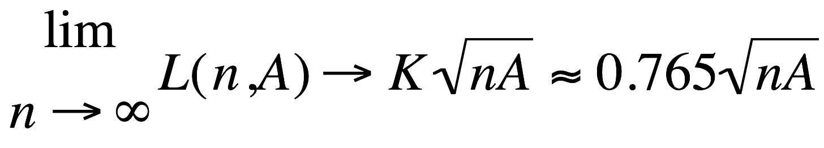
Probabilistic View of the Euclidean Traveling Salesman Problem

Slide 23
Probabilistic View of the Euclidean Traveling Salesman Problem
Very useful formula:
Estimate order of magnitude
Comparing to heuristic solution
Sanity checks for non-TSP but similar type problems.

Slide 24
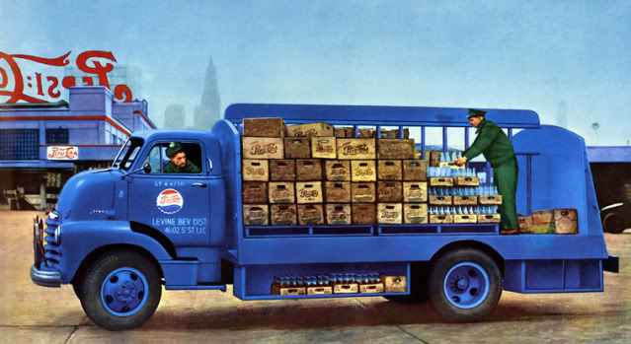
Delivery AND Pickup!

Slide 25
2. Vehicle Routing Problem (VRP)
Single Depot
n customers or destinations
Weights Q_{i} (i = 1, 2, . . . , n)
Vehicles have identical maximum weight capacities and maximum route time (or distance) constraints.
They must all start and finish their routes at the depot, D.

Slide 26
VRP - Continued
The Problem: Obtain a set of delivery routes from the depot, D, to the various demand points to minimize the total distance covered by the entire fleet; subject to constraints.
A feasible solution assumed.
Also assumed: Capacity of a vehicle greater than largest Q_{i}.

Slide 27
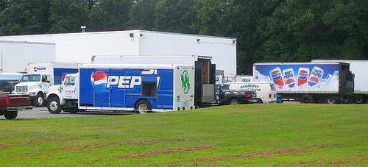
A Depot

Slide 28
The Savings Algorithm
8
3
9
Depot (D)
1
2
7
10
4
5
6

Slide 29


The Clark-Wright
Savings Algorithm
Invented for vehicle routing; works well for TSP
Connect every node to the origin (“depot”) through a “round trip” (n-1 tours)
Merge tours, one node at a time, by maximizing “savings”
s(i,j) = d(D,i) + d(D,j) – d(i,j).
What about more complex tours?
Tours should not violate such constraints as:
  Vehicle capacity, Maximum length of a tour, Maximum number of stops per tour
O(n³)
Performs very well in practice; very flexible
Li, F., B. Golden and E. Wasil (2005), “Very large-scale vehicle routing”, Computers and Opers. Research

Slide 30
What Happens if you Run the VRP Backwards?
Pick up product at the n customers and deliver it to the depot.
Could be solid waste collection or some other pick-up service.
Getting exact solutions for large problems is difficult. But heuristics seem to work fine.

Slide 31
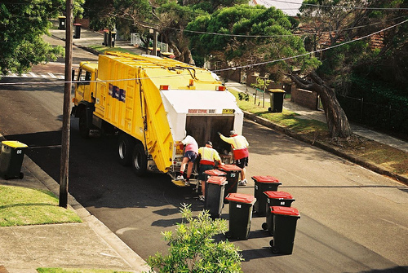
What Happens if you Run the VRP Backwards?

Slide 32
VRP: All Sorts of Other Constraints Possible
Time windows very difficult
Also, why not schedule over a week, rather than day-by-day?

Slide 33
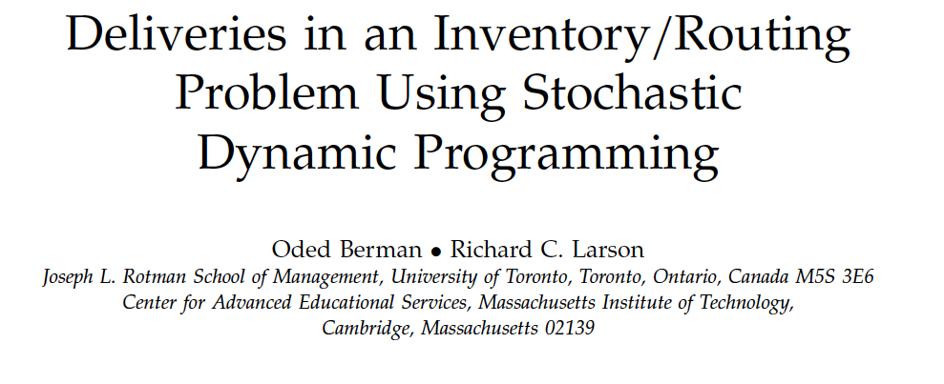

3.
Paper is Now Posted on Class Web Site

Slide 34
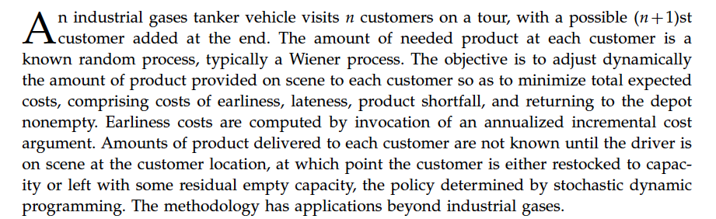

Slide 35
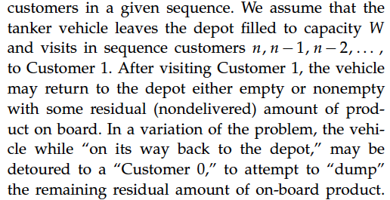

Slide 36
More Details
Product use is random process, where at any given time product remaining is Gaussian with mean and variance that grow linearly with time. (subject to truncations)
For a subset of customers there may be product level monitoring technologies.

Slide 37
How to Use
Could use as a more realistic and sophisticated model of a tour in a Clark-Wright Savings Algorithm.
Certainly can use as a guide for optimal execution of any given tour.
Decisions: Fill up to a point? Stop off at Customer Zero for Dump?

Slide 38
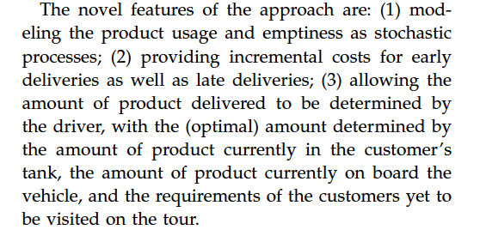

Slide 39
Incremental Cost Structure
Think of filling up the gas tank of your own car.

Slide 40
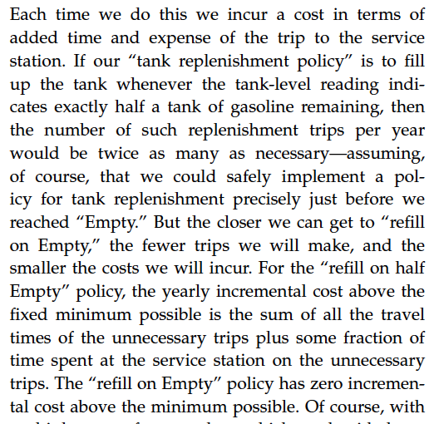

Slide 41
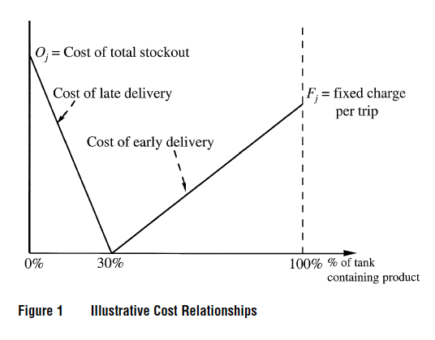

Slide 42
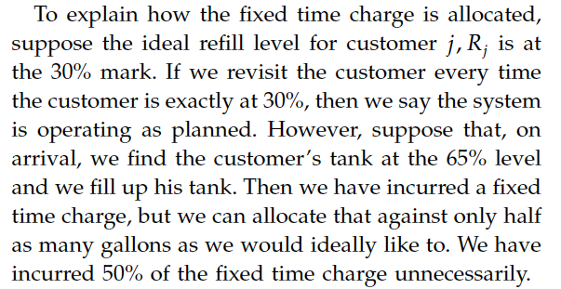
Allocating Fixed Time Charge

Slide 43
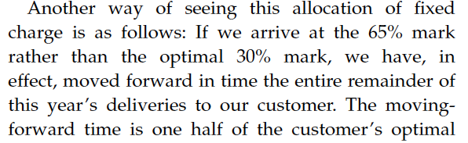
Allocating Fixed Time Charge

Slide 44
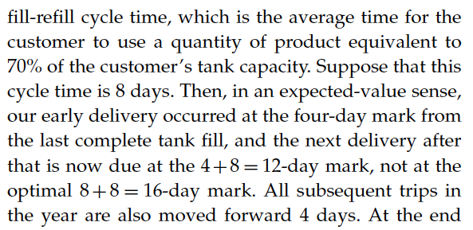
Allocating Fixed Time Charge
T
This all adds up over the year!

Slide 45
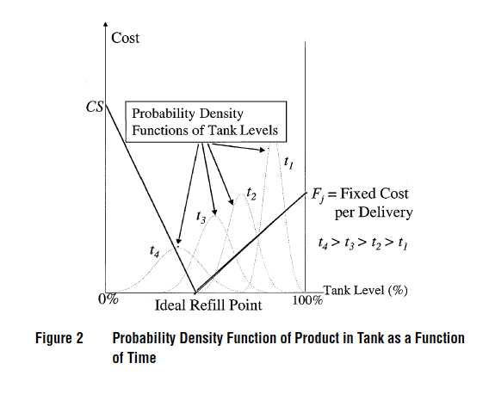

Slide 46
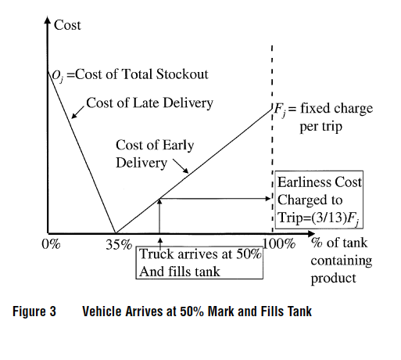

Slide 47
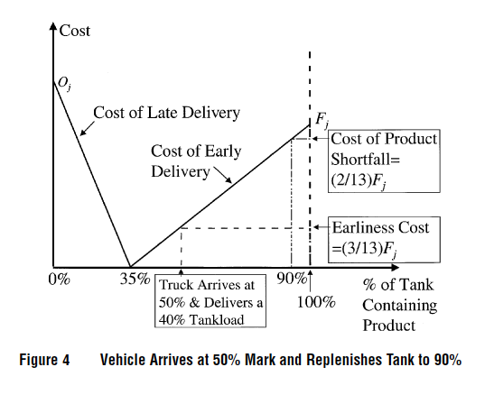

Slide 48
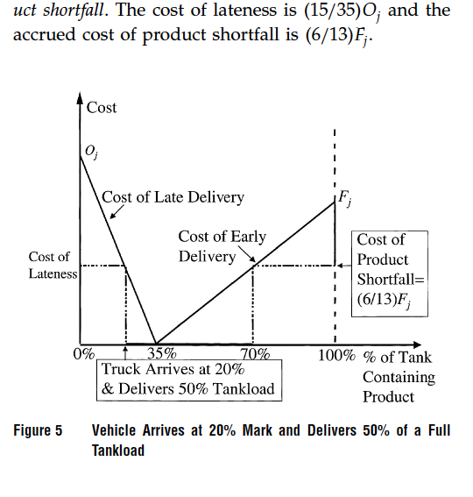

Slide 49
Stochastic Dynamic Programming
This is the method that is used to optimally perform each tour.
Details in paper.
Further research needed: Embed this into a weekly algorithm, using DP and Savings Heuristics.

Slide 50
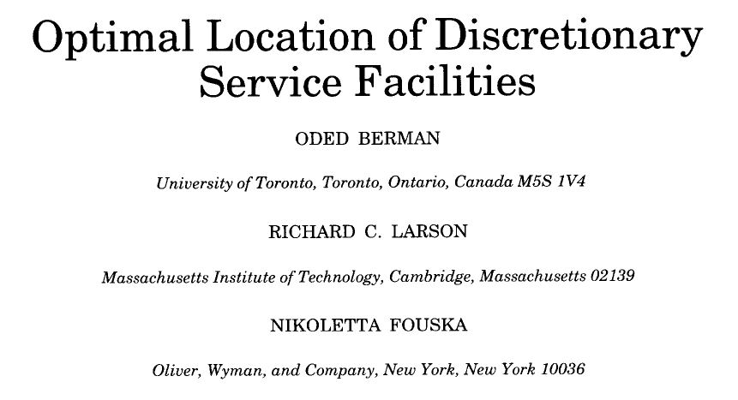
4.
Paper now on class web site

Slide 51
Behavioral Assumptions
Hakimi-type median and center problems
  -Assumes a 1-stop special-purpose trip
What about everyday life for ATM’s, gasoline fill-ups, stopping at a store on the way home.
  -Want to stop along a route already planned for something else.
  Assume we know all paths and their frequencies.

Slide 52

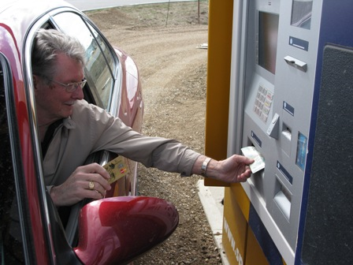
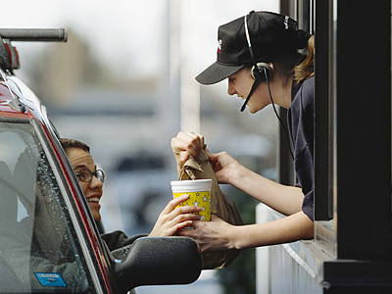



Slide 53

Why?

Slide 54
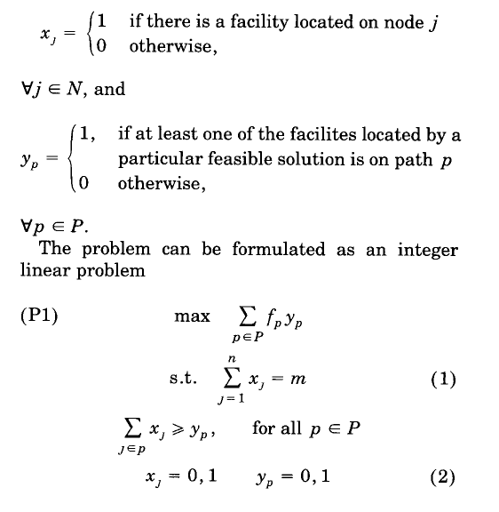
NP Hard

Slide 55
Summary of Locating Discretionary Service Facilities
Solve with greedy heuristic.
Unsolved problem: What if we only have partial information about travel paths?

Slide 56
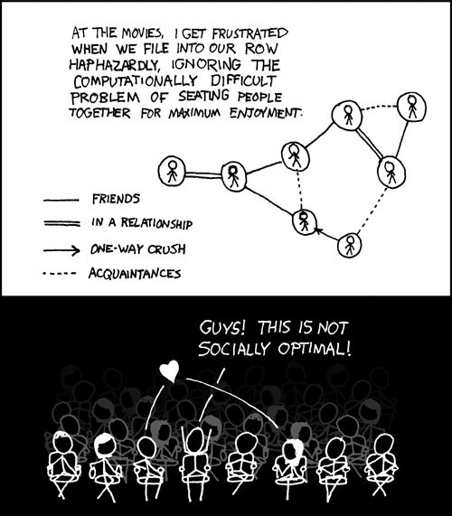
And then there are
Social Networks!

Slide 57

The Friendship Paradox: Why We Can’t All be Popular!
Katrina LaCurts
Lecturer, EECS, MIT
http://bit.ly/1MSc68I

Slide 58
The Friendship Paradox: Why We Can’t All be Popular!

